Slide 1
UML 2
29 Apr 18 | Start
30 Apr 18 | 1: 3-9
21 May 18 | 1: 10-13
Appendix
Online

Slide 2
UML 2
Ch | Date
1 | 00 May 18
2
3
4
5
6
7
8
UML 2.0 Distilled Martin Fowler 10 2003

Slide 3
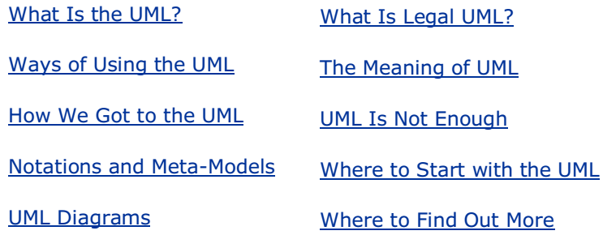
1
Introduction

Slide 4
What Is the UML?
The Unified Modeling Language (UML) is
a family of graphical notations, backed by single meta-model,
that help in describing and designing software systems,
particularly software systems built using the object-oriented (OO) style
That's a somewhat simplified definition. In fact, the UML is a few different things to different people.
This comes both from its own history and from the different views that people have about what makes an effective software engineering process.
As a result, my task in much of this chapter is to set the scene for this book by explaining the different ways in which people see and use the UML.
Graphical modeling languages have been around in the software industry for a long time.
The fundamental driver behind them all is that programming languages are not at a high enough level of abstraction to facilitate discussions about design.
Despite the fact that graphical modeling languages have been around for a long time, there is an enormous amount of dispute in the software industry about their role.
These disputes play directly into how people perceive the role of the UML itself.

Slide 5
What Is the UML? |
The UML is a relatively open standard, controlled by the Object Management Group (OMG), an open consortium of companies.
The OMG was formed to build standards that supported interoperability, specifically the interoperability of object-oriented systems.
The OMG is perhaps best known for the CORBA (Common Object Request Broker Architecture) standards.
The UML was born out of the unification of the many object-oriented graphical modeling languages that thrived in the late 1980s and early 1990s.
Since its appearance in 1997, it has relegated that particular tower of Babel to history.
That's a service I, and many other developers, am deeply thankful for.

Slide 6
Where to Find Out More
This book is not a complete and definitive reference to the UML, let alone OO analysis and design.
A lot of words are out there and a lot of worthwhile things to read.
As I discuss the individual topics, I also mention other books you should go to for more in-depth information there.
Here are some general books on the UML and object-oriented design. As with all book recommendations, you may need to check which version of the UML they are written for.
As of June 2003, no published book uses UML 2.0, which is hardly surprising, as the ink is barely dry on the standard.
The books I suggest are good books, but I can't tell whether or when they will be updated to the UML 2 standard.
If you are new to objects, I recommend my current favorite introductory book: [Larman].
The author's strong responsibility-driven approach to design is worth following.
For the conclusive word on the UML, you should look to the official standards documents; but remember, they are written for consenting methodologists in the privacy of their own cubicles.
For a much more digestible version of the standard, take a look at [Rumbaugh, UML Reference].

Slide 7
Where to Find Out More |
For more detailed advice on object-oriented design, you'll learn many good things from [Martin].
I also suggest that you read books on patterns for material that will take you beyond the basics.
Now that the methods war is over, patterns (page 27) are where most of the interesting material about analysis and design appears.

Slide 8
Ways of Using the UML
At the heart of the role of the UML in software development are the different ways in which people want to use it, differences that carry over from other graphical modeling languages.
These differences lead to long and difficult arguments about how the UML should be used.
To untangle this, Steve Mellor and I independently came up with a characterization of the three modes in which people use the UML:
Sketch
Blueprint
Programming language
The line between blueprints and sketches is somewhat blurry, but the distinction, I think, rests on the fact that
sketches are deliberately incomplete, highlighting important information
While blueprints intend to be comprehensive, often with the aim of reducing programming to a simple and fairly mechanical activity
In a sound bite, I'd say that
sketches are explorative
while blueprints are definitive

Slide 9
UML as Sketch
By far the most common of the three, at least to my biased eye, is UML as sketch.
In this usage, developers use the UML to help communicate some aspects of a system.
As with blueprints, you can use sketches in a
forward-engineering or
reverse-engineering direction.
Forward engineering draws a UML diagram before you write code, while reverse engineering builds a UML diagram from existing code in order to help understand it.
The essence of sketching is selectivity. With forward sketching, you rough out some issues in code you are about to write, usually discussing them with a group of people on your team.
Your aim is to use the sketches to help communicate ideas and alternatives about what you're about to do
You don't talk about all the code you are going to work on, only important issues that you want to run past your colleagues first or sections of the design that you want to visualize before you begin programming.
Sessions like this can be very short:
a 10-minute session to discuss a few hours of programming or
a day to discuss a 2-week iteration

Slide 10
UML as Sketch |
With reverse engineering, you use sketches to explain how some part of a system works.
You don't show every class, simply those that are interesting and worth talking about before you dig into the code.
Because sketching is pretty informal and dynamic, you need to do it quickly and collaboratively, so a common medium is a whiteboard.
Sketches are also useful in documents, in which case the focus is communication rather than completeness.
The tools used for sketching are lightweight drawing tools, and often people aren't too particular about keeping to every strict rule of the UML.
Most UML diagrams shown in books, such as my other books, are sketches.
Their emphasis is on selective communication rather than complete specification.

Slide 11
UML as Blueprint
In contrast, UML as blueprint is about completeness.
In forward engineering, the idea is that blueprints are developed by a designer whose job is to build a detailed design for a programmer to code up.
That design should be sufficiently complete in that all design decisions are laid out, and the programmer should be able to follow it as a pretty straightforward activity that requires little thought.
The designer may be the same person as the programmer, but usually the designer is a more senior developer who designs for a team of programmers.
The inspiration for this approach is other forms of engineering in which professional engineers create engineering drawings that are handed over to construction companies to build.
Blueprinting may be used for all details, or a designer may draw blueprints to a particular area.
A common approach is for a designer to develop blueprint-level models as far as interfaces of subsystems but then let developers work out the details of implementing those details.
In reverse engineering, blueprints aim to convey detailed information about the code either in paper documents or as an interactive graphical browser.
The blueprints can show every detail about a class in a graphical form that's easier for developers to understand.

Slide 12
UML as Blueprint |
Blueprints require much more sophisticated tools than sketches do in order to handle the details required for the task.
Specialized CASE (computer-aided software engineering) tools fall into this category, although the term CASE has become a dirty word, and vendors try to avoid it now.
Forward-engineering tools support diagram drawing and back it up with a repository to hold the information.
Reverse-engineering tools read source code and interpret from it into the repository and generate diagrams.
Tools that can do both forward and reverse engineering like this are referred to as round-trip tools.
Some tools use the source code itself as the repository and use diagrams as a graphic viewport on the code.
These tools tie much more closely into programming and often integrate directly with programming editors.
I like to think of these as tripless tools.

Slide 13
UML as Programming Language
As you do more and more in the UML and the programming gets increasingly mechanical, it becomes obvious that the programming should be automated.
Indeed, many CASE tools do some form of code generation, which automates building a significant part of a system.
Eventually, however, you reach the point at which all the system can be specified in the UML, and you reach UML as programming language.
In this environment, developers draw UML diagrams that are compiled directly to executable code, and the UML becomes the source code.
Obviously, this usage of UML demands particularly sophisticated tooling. (Also, the notions of forward and reverse engineering don't make any sense for this mode, as the UML and source code are the same thing.)
One of the interesting questions around the UML as programming language is how to model behavioral logic.
UML 2 offers three ways of behavioral modeling:
Interaction diagrams
State diagrams, and
Activity diagrams

Slide 14
UML as Programming Language |
All have their proponents for programming in.
If the UML does gain popularity as a programming language, it will be interesting to see which of these techniques become successful.
Another way in which people look at the UML is the range between using it for conceptual and for software modeling.
Most people are familiar with the UML used for software modeling.
In this software perspective, the elements of the UML map pretty directly to elements in a software system.
As we shall see, the mapping is by no means prescriptive, but when we use the UML, we are talking about software elements.
With the conceptual perspective, the UML represents a description of the concepts of a domain of study.
Here, we aren't talking about software elements so much as we are building a vocabulary to talk about a particular domain.
There are no hard-and-fast rules about perspective; as it turns out, there's really quite a large range of usage.
Some tools automatically turn source code into the UML diagrams, treating the UML as an alternative view of the source. That's very much a software perspective.

Slide 15
UML as Programming Language ||
If you use UML diagrams to try and understand the various meanings of the terms asset pool with a bunch of accountants, you are in a much more conceptual frame of mind.

Slide 16
Previous Edition
In previous editions of this book, I split the software perspective into
specification (interface)
Implementation
In practice, I found that it was too hard to draw a precise line between the two, so I feel that the distinction is no longer worth making a fuss about.
However, I'm always inclined to emphasize interface rather than implementation in my diagrams.
These different ways of using the UML lead to a host of arguments about what UML diagrams mean and what their relationship is to the rest of the world.
In particular, it affects the relationship between the UML and source code.
Some people hold the view that the UML should be used to create a design that is independent of the programming language that's used for implementation.
Others believe that language-independent design is an oxymoron, with a strong emphasis on the moron.
Another difference in viewpoints is what the essence of the UML is.
In my view, most users of the UML, particularly sketchers, see the essence of the UML to be the diagrams.
However, the creators of the UML see the diagrams as secondary; the essence of the UML is the meta-model.

Slide 17
Previous Edition |
This view also makes sense to blueprinters and UML programming language users.
So whenever you read anything involving the UML, it's important to understand the point of view of the author.
Only then can you make sense of the often fierce arguments that the UML encourages.
Having said all that, I need to make my biases clear.
Almost all the time, my use of the UML is as sketches.
I find the UML sketches useful with forward and reverse engineering and in both conceptual and software perspectives.
I'm not a fan of detailed forward-engineered blueprints; I believe that it's too difficult to do well and slows down a development effort.
Blueprinting to a level of subsystem interfaces is reasonable, but even then you should expect to change those interfaces as developers implement the interactions across the interface.
The value of reverse-engineered blueprints is dependent on how the tool works.
If it's used as a dynamic browser, it can be very helpful; if it generates a large document, all it does is kill trees.
I see the UML as programming language as a nice idea but doubt that it will ever see significant usage.

Slide 18
Previous Edition ||
I'm not convinced that graphical forms are more productive than textual forms for most programming tasks and that even if they are, it's very difficult for a language to be widely accepted.
As a result of my biases, this book focuses much more on using the UML for sketching. Fortunately, this makes sense for a brief guide.
I can't do justice to the UML in its other modes in a book this size, but a book this size makes a good introduction to other books that can.
So if you're interested in the UML in its other modes, I'd suggest that you treat this book as an introduction and move on to other books as you need them.
If you're interested only in sketches, this book may well be all you need.

Slide 19
Model Driven Architecture and Executable UML
When people talk about the UML, they also often talk about Model Driven Architecture (MDA) [Kleppe et al.].
Essentially, MDA is a standard approach to using the UML as a programming language; the standard is controlled by the OMG, as is the UML.
By producing a modeling environment that conforms to the MDA, vendors can create models that can also work with other MDA-compliant environments.
MDA is often talked about in the same breath as the UML because MDA uses the UML as its basic modeling language.
But, of course, you don't have to be using MDA to use the UML.
MDA divides development work into two main areas.
Modelers represent a particular application by creating a Platform Independent Model (PIM).
The PIM is a UML model that is independent of any particular technology.
Tools can then turn a PIM into a Platform Specific Model (PSM).
The PSM is a model of a system targeted to a specific execution environment.
Further tools then take the PSM and generate code for that platform.
The PSM could be UML but doesn't have to be.

Slide 20
Warehousing System with MDA
So if you want to build a warehousing system using MDA, you would start by creating a single PIM of your warehousing system.
If you then wanted this warehousing system to run on J2EE and .NET, you would use some vendor tools to create two PSMs: one for each platform.
Then further tools would generate code for the two platforms.
If the process of going from PIM to PSM to final code is completely automated, we have the UML as programming language.
If any of the steps is manual, we have blueprints.
Steve Mellor has long been active in this kind of work and has recently used the term Executable UML [Mellor and Balcer].

Slide 21
Executable UML
Executable UML is similar to MDA but uses slightly different terms.
Similarly, you begin with a platform-independent model that is equivalent to MDA's PIM.
However, the next step is to use a Model Compiler to turn that UML model into a deployable system in a single step; hence, there's no need for the PSM.
As the term compiler suggests, this step is completely automatic.
The model compilers are based on reusable archetypes.
An archetype describes how to take an executable UML model and turn it into a particular programming platform.
So for the warehousing example, you would buy a model compiler and two archetypes (J2EE and .NET).
Run each archetype on your executable UML model, and you have your two versions of the warehousing system.
Executable UML does not use the full UML standard; many constructs of UML are considered to be unnecessary and are therefore not used.
As a result, Executable UML is simpler than full UML.

Slide 22
Executable UML |
All this sounds good, but how realistic is it?
In my view, there are two issues here.
First is the question of the tools: whether they are mature enough to do the job.
This is something that changes over time; certainly, as I write this, they aren't widely used, and I haven't seen much of them in action.
A more fundamental issue is the whole notion of the UML as a programming language.
In my view, it's worth using the UML as a programming language only if it results in something that's significantly more productive than using another programming language.
I'm not convinced that it is, based on various graphical development environments I've worked with in the past.
Even if it is more productive, it still needs to get a critical mass of users for it to make the mainstream.
That's a big hurdle in itself. Like many old Smalltalkers, I consider Smalltalk to be much more productive than current mainstream languages.
But as Smalltalk is now only a niche language, I don't see many projects using it. To avoid Smalltalk's fate, the UML has to be luckier, even if it is superior.
One of the interesting questions around the UML as programming language is how

Slide 23
How We Got to the UML
I'll admit, I'm a history buff. My favorite idea of light reading is a good history book.
But I also know that it's not everybody's idea of fun.
I talk about history here because I think that in many ways, it's hard to understand where the UML is without understanding the history of how it got here.
In the 1980s, objects began to move away from the research labs and took their first steps toward the "real" world.
Smalltalk stabilized into a platform that people could use, and C++ was born.
At that time, various people started thinking about object-oriented graphical design languages.
The key books about object-oriented graphical modeling languages appeared between 1988 and 1992.

Slide 24
Leading Figures
Leading figures included
Grady Booch [Booch, OOAD]
Peter Coad [Coad, OOA], [Coad, OOD]
Ivar Jacobson (Objectory) [Jacobson, OOSE]
Jim Odell [Odell]
Jim Rumbaugh (OMT) [Rumbaugh, insights], [Rumbaugh, OMT]
Sally Shlaer and Steve Mellor [Shlaer and Mellor, data], [Shlaer and Mellor, states]
Rebecca Wirfs-Brock (Responsibility Driven Design) [Wirfs-Brock]
Each of those authors was now informally leading a group of practitioners who liked those ideas.
All these methods were very similar, yet they contained a number of often annoying minor differences among them.
The same basic concepts would appear in very different notations, which caused confusion to my clients.

Slide 25
Path to Standardization
During that heady time, standardization was as talked about as it was ignored.
A team from the OMG tried to look at standardization but got only an open letter of protest from all the key methodologists. (This reminds me of an old joke. Question: What is the difference between a methodologist and a terrorist? Answer: You can negotiate with a terrorist.)
The cataclysmic event that first initiated the UML was when Jim Rumbaugh left GE to join Grady Booch at Rational (now a part of IBM).
The Booch/Rumbaugh alliance was seen from the beginning as one that could get a critical mass of market share.
Grady and Jim proclaimed that "the methods war is over we won," basically declaring that they were going to achieve standardization "the Microsoft way.“
A number of other methodologists suggested forming an Anti-Booch Coalition.
By OOPSLA '95, Grady and Jim had prepared their first public description of their merged method: version 0.8 of the Unified Method documentation.
Even more significant, they announced that Rational Software had bought Objectory and that therefore, Ivar Jacobson would be joining the Unified team.

Slide 26
Path to Standardization |
Rational held a well-attended party to celebrate the release of the 0.8 draft. (The highlight of the party was the first public display of Jim Rumbaugh's singing; we all hope it's also the last.)
The next year saw a more open process emerge.
The OMG, which had mostly stood on the sidelines, now took an active role.
Rational had to incorporate Ivar's ideas and also spent time with other partners. More important, the OMG decided to take a major role.
At this point, it's important to realize why the OMG got involved.
Methodologists, like book authors, like to think that they are important.
But I don't think that the screams of book authors would even be heard by the OMG.
What got the OMG involved were the screams of tools vendors, all of which were frightened that a standard controlled by Rational would give Rational tools an unfair competitive advantage.
As a result, the vendors energized the OMG to do something about it, under the banner of CASE tool interoperability.
This banner was important, as the OMG was all about interoperability.
The idea was to create a UML that would allow CASE tools to freely exchange models.
Mary Loomis and Jim Odell chaired the initial task force.

Slide 27
Path to Standardization ||
Odell made it clear that he was prepared to give up his method to a standard, but he did not want a Rational-imposed standard.
In January 1997, various organizations submitted proposals for a methods standard to facilitate the interchange of models.

Slide 28
Revisions
Rational collaborated with a number of other organizations and released version 1.0 of the UML documentation as their proposal, the first animal to answer to the name Unified Modeling Language.
Then followed a short period of arm twisting while the various proposals were merged.
The OMG adopted the resulting 1.1 as an official OMG standard. Some revisions were made later on.
Revision 1.2 was entirely cosmetic.
Revision 1.3 was more significant.
Revision 1.4 added a number of detailed concepts around components and profiles.
Revision 1.5 added action semantics.

Slide 29
Creators
When people talk about the UML, they credit mainly
Grady Booch
Ivar Jacobson
Jim Rumbaugh
as its creators.
They are generally referred to as the Three Amigos, although wags like to drop the first syllable of the second word.
Although they are most credited with the UML, I think it somewhat unfair to give them the dominant credit.
The UML notation was first formed in the Booch/Rumbaugh Unified Method.
Since then, much of the work has been led by OMG committees.
During these later stages, Jim Rumbaugh is the only one of the three to have made a heavy commitment.
My view is that it's these members of the UML committee process that deserve the principal credit for the UML.

Slide 30
Notations and Meta-Models
The UML, in its current state, defines a notation and a meta-model.
The notation is the graphical stuff you see in models; it is the graphical syntax of the modeling language.
For instance, class diagram notation defines how items and concepts, such as class, association, and multiplicity, are represented.
Of course, this leads to the question of what exactly is meant by an association or multiplicity or even a class. Common usage suggests some informal definitions, but many people want more rigor than that.
The idea of rigorous specification and design languages is most prevalent in the field of formal methods.
In such techniques, designs and specifications are represented using some derivative of predicate calculus. Such definitions are mathematically rigorous and allow no ambiguity.
However, the value of these definitions is by no means universal. Even if you can prove that a program satisfies a mathematical specification, there is no way to prove that the mathematical specification meets the real requirements of the system. Most graphical modeling languages have very little rigor; their notation appeals to intuition rather than to formal definition. On the whole, this does not seem to have done much harm. These methods may be informal, but many people still find them useful—and it is usefulness that counts.

Slide 31
UML Diagrams
UML 2 describes 13 official diagram types listed in Table 1.1 and classified as indicated on Figure 1.2.
Although these diagram types are the way many people approach the UML and how I've organized this book, the UML's authors do not see diagrams as the central part of the UML.
As a result, the diagram types are not particularly rigid.
Often, you can legally use elements from one diagram type on another diagram.
The UML standard indicates that certain elements are typically drawn on certain diagram types, but this is not a prescription.

Slide 32
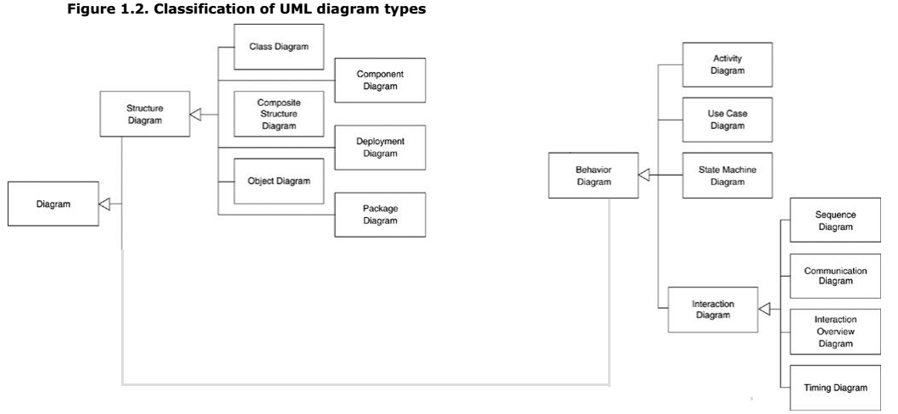
Figure 1.2

Slide 33
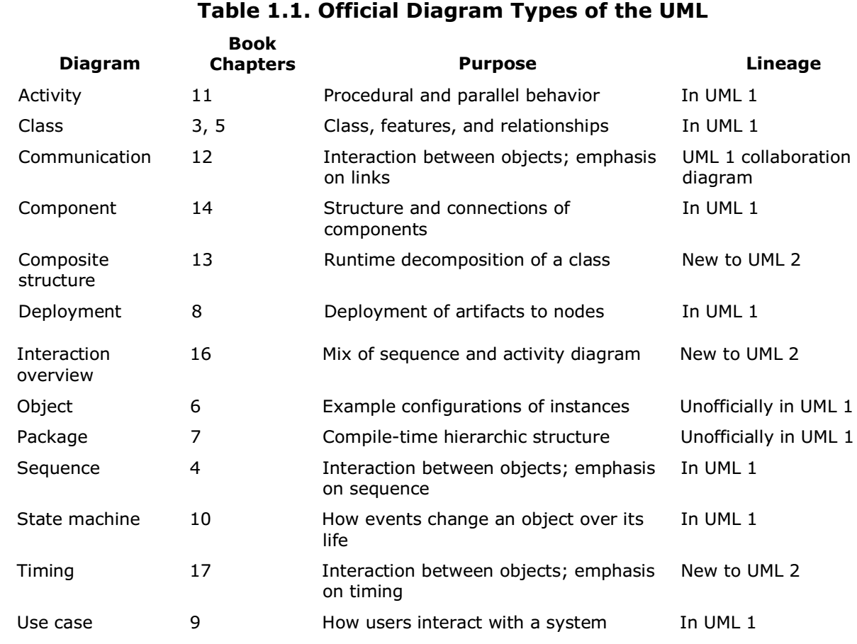
Table 1.1

Slide 34
What Is Legal UML?
At first blush, this should be a simple question to answer: Legal UML is what is defined as well formed in the specification. In practice, however, the answer is a bit more complicated. An important part of this question is whether the UML has descriptive or prescriptive rules. A language with prescriptive rules is controlled by an official body that states what is or isn't legal in the language and what meaning you give to utterances in that language. A language with descriptive rules is one in which you understand its rules by looking at how people use the language in practice. Programming languages tend to have prescriptive rules set by a standards committee or dominant vendor, while natural languages, such as English, tend to have descriptive rules whose meaning is set by convention. UML is quite a precise language, so you might expect it to have prescriptive rules. But UML is often considered to be the software equivalent of the blueprints in other engineering disciplines, and these blueprints are not prescriptive notations. No committee says what the legal symbols are on a structural engineering drawing; the notation has been accepted by convention, similarly to a natural language. Simply having a standards body doesn't do the trick either, because people in the field may not follow everything the standards body says; just ask the French about the Académie Française. In addition, the UML is so complex that the standard is often open to multiple interpretations. Even the UML leaders who reviewed this book would disagree on interpretation of the UML standard.
(Page 23).

Slide 35
The Meaning of UML
One of the awkward issues about the UML is that, although the specification describes in great detail what well-formed UML is, it doesn't have much to say about what the UML means outside of the rarefied world of the UML meta-model. No formal definition exists of how the UML maps to any particular programming language. You cannot look at a UML diagram and say exactly what the equivalent code would look like. However, you can get a rough idea of what the code would look like. In practice, that's enough to be useful. Development teams often form their local conventions for these, and you'll need to be familiar with the ones in use.
(Page 24).

Slide 36
UML Is Not Enough
Although the UML provides quite a considerable body of various diagrams that help to define an application, it's by no means a complete list of all the useful diagrams that you might want to use. In many places, different diagrams can be useful, and you shouldn't hesitate to use a non-UML diagram if no UML diagram suits your purpose. Figure 1.3, a screen flow diagram, shows the various screens on a user interface and how you move between them. I've seen and used these screen flow diagrams for many years. I've never seen more than a very rough definition of what they mean; there isn't anything like it in the UML, yet I've found it a very useful diagram.
(Page 24).

Slide 37
Where to Start with the UML
Nobody, not even the creators of the UML, understand or use all of it. Most people use a small subset of the UML and work with that. You have to find the subset of the UML that works for you and your colleagues. If you are starting out, I suggest that you concentrate first on the basic forms of class diagrams and sequence diagrams. These are the most common and, in my view, the most useful diagram types.
(Page 25).

Slide 38
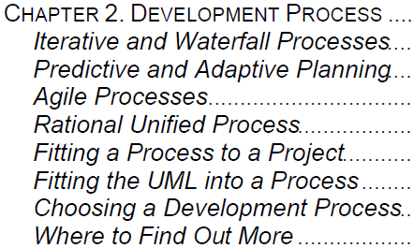
2
Development Process

Slide 39
Intro
As I've already mentioned, the UML grew out of a bunch of OO analysis and design methods.
To some extent, all of them mixed a graphical modeling language with a process that described how to go about developing software.
Interestingly, as the UML was formed, the various players discovered that although they could agree on a modeling language, they most certainly could not agree on a process.
As a result, they agreed to leave any agreement on process until later and to confine the UML to being a modeling language.
The title of this book is UML Distilled, so I could have safely ignored process.
However, I don't believe that modeling techniques make any sense without knowing how they fit into a process.
The way you use the UML depends a lot on the style of process you use.
As a result, I think that it's important to talk about process first so that you can see the context for using the UML.
I'm not going to go into great detail on any particular process; I simply want to give you enough information to see this context and pointers to where you can find out more.

Slide 40
Intro |
When you hear people discuss the UML, you often hear them talk about the Rational Unified Process (RUP).
RUP is one process—or, more strictly, a process framework—that you can use with the UML.
But other than the common involvement of various people from Rational and the name "unified," it doesn't have any special relationship to the UML.
The UML can be used with any process.
RUP is a popular approach and is discussed on page 25.

Slide 41
Iterative and Waterfall Processes
One of the biggest debates about process is that between
Waterfall
iterative styles.
The terms often get misused, particularly as iterative is seen as fashionable, while the waterfall process seems to wear plaid trousers. As a result, many projects claim to do iterative development but are really doing waterfall. The essential difference between the two is how you break up a project into smaller chunks. If you have a project that you think will take a year, few people are comfortable telling the team to go away for a year and to come back when done. Some breakdown is needed so that people can approach the problem and track progress. The waterfall style breaks down a project based on activity. To build software, you have to do certain activities: requirements analysis, design, coding, and testing. Our 1-year project might thus have a 2-month analysis phase, followed by a 4-month design phase, followed by a 3-month coding phase, followed by a 3-month testing phase. The iterative style breaks down a project by subsets of functionality. You might take a year and break it into 3-month iterations. In the first iteration, you'd take a quarter of the requirements and do the complete software life cycle for that quarter: analysis, design, code, and test. At the end of the first iteration, you'd have a system that does a quarter of the needed functionality. Then you'd do a second iteration so that at the end of 6 months, you'd have a system that does half the functionality.

Slide 49
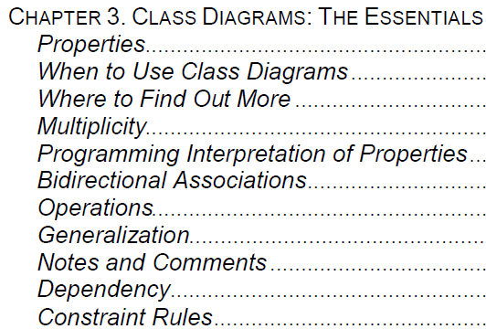
3
Class Diagrams: The Essentials

Slide 50
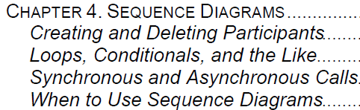
4
Sequence Diagrams

Slide 51
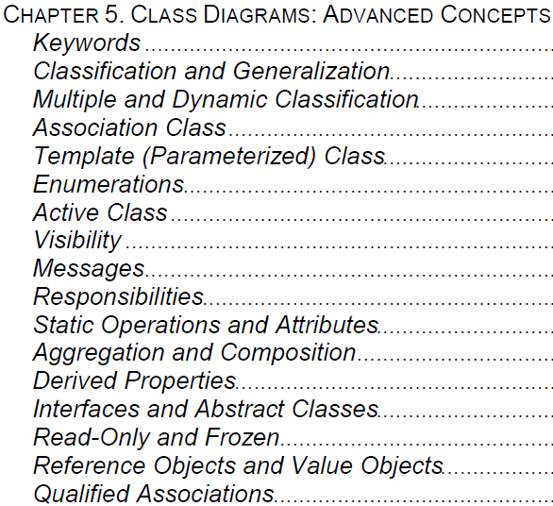
5
Class Diagrams: Advanced Concepts

Slide 52
6

Slide 53
UML History
UML Class Diagram Notations
Modeling Language - Wiki

Slide 54
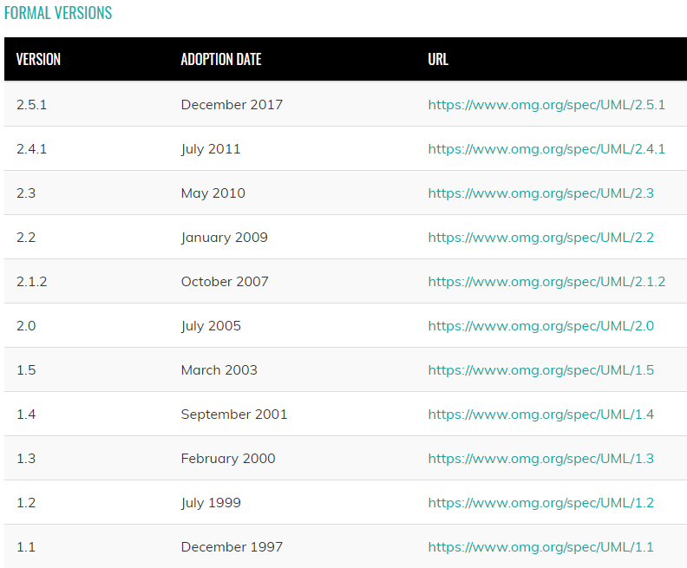
UML History

Slide 55
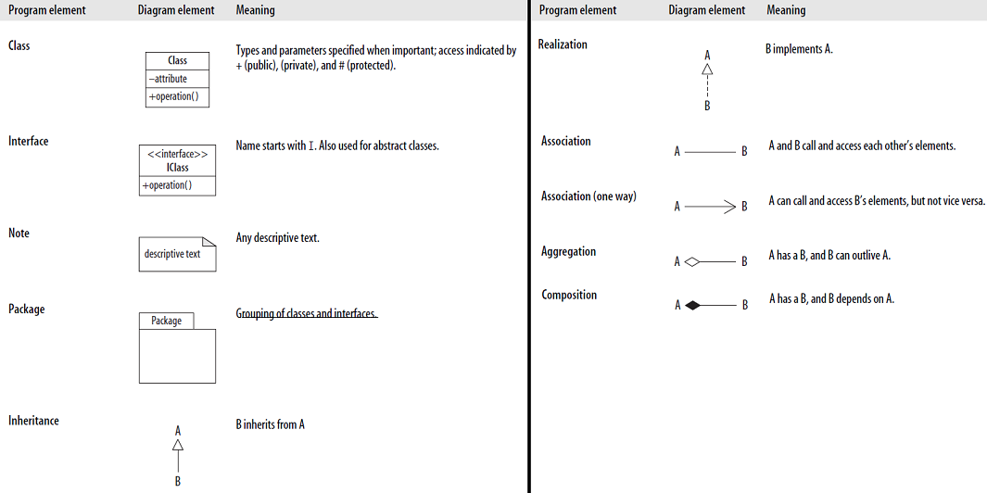
UML Class Diagram Notations

Slide 56
Modeling Language - Wiki
A modeling language is any artificial language that can be used to express information or knowledge or systems in a structure that is defined by a consistent set of rules.
The rules are used for interpretation of the meaning of components in the structure.
A modeling language can be graphical or textual.
Graphical modeling languages use a diagram technique with named symbols that represent concepts and lines that connect the symbols and represent relationships and various other graphical notation to represent constraints.
Textual modeling languages may use standardized keywords accompanied by parameters or natural language terms and phrases to make computer-interpretable expressions.
An example of a graphical modeling language and a corresponding textual modeling language is EXPRESS.
Not all modeling languages are executable, and for those that are, the use of them doesn't necessarily mean that programmers are no longer required.
On the contrary, executable modeling languages are intended to amplify the productivity of skilled programmers, so that they can address more challenging problems, such as parallel computing and distributed systems.
A large number of modeling languages appear in the literature.

Slide 57
Graphical Modeling Languages
Example of graphical modeling languages in the field of computer science, project management and systems engineering:
Behavior Trees are a formal, graphical modeling language used primarily in systems and software engineering. Commonly used to unambiguously represent the hundreds or even thousands of natural language requirements that are typically used to express the stakeholder needs for a large-scale software-integrated system.
Business Process Modeling Notation (BPMN, and the XML form BPML) is an example of a Process Modeling language.
C-K theory consists of a modeling language for design processes.
DRAKON is a general-purpose algorithmic modeling language for specifying software-intensive systems, a schematic representation of an algorithm or a stepwise process, and a family of programming languages.
EXPRESS and EXPRESS-G (ISO 10303-11) is an international standard general-purpose data modeling language.
Extended Enterprise Modeling Language (EEML) is commonly used for business process modeling across a number of layers.
Flowchart is a schematic representation of an algorithm or a stepwise process.

Slide 58
Graphical Modeling Languages |
Fundamental Modeling Concepts (FMC) modeling language for software-intensive systems.
IDEF is a family of modeling languages, which include IDEF0 for functional modeling, IDEF1X for information modeling, IDEF3 for business process modeling, IDEF4 for Object-Oriented Design and IDEF5 for modeling ontologies.
Jackson Structured Programming (JSP) is a method for structured programming based on correspondences between data stream structure and program structure.
LePUS3 is an object-oriented visual Design Description Language and a formal specification language that is suitable primarily for modeling large object-oriented (Java, C++, C#) programs and design patterns.
Object-Role Modeling (ORM) in the field of software engineering is a method for conceptual modeling, and can be used as a tool for information and rules analysis.
Petri nets use variations on exactly one diagramming technique and topology, namely the bipartite graph.
The simplicity of its basic user interface easily enabled extensive tool support over the years, particularly in the areas of model checking, graphically oriented simulation, and software verification.
Southbeach Notation is a visual modeling language used to describe situations in terms of agents that are considered useful or harmful from the modeler's perspective.
The notation shows how the agents interact with each other and whether this interaction improves or worsens the situation.

Slide 59
Graphical Modeling Languages ||
Specification and Description Language (SDL) is a specification language targeted at the unambiguous specification and description of the behavior of reactive and distributed systems.
SysML is a Domain-Specific Modeling language for systems engineering that is defined as a UML profile (customization).
Unified Modeling Language (UML) is a general-purpose modeling language that is an industry standard for specifying software-intensive systems. UML 2.0, the current version, supports thirteen different diagram techniques, and has widespread tool support.
Service-oriented modeling framework (SOMF) is a holistic language for designing enterprise and application level architecture models in the space of enterprise architecture, virtualization, service-oriented architecture (SOA), cloud computing, and more.[2]
Architecture description language (ADL) is a language used to describe and represent the systems architecture of a system.
AADL (AADL) is a modeling language that supports early and repeated analyses of a system's architecture with respect to performance-critical properties through an exetendable notation, a tool framework, and precisely defined semantics.

Slide 60

Textual Modeling Languages
Information models can also be expressed in formalized natural languages, such as Gellish.
Gellish has natural language variants such as Gellish Formal English and Gellish Formal Dutch (Gellish Formeel Nederlands), etc.
Gellish Formal English is an information representation language or semantic modeling language that is defined in the Gellish English Dictionary-Taxonomy, which has the form of a Taxonomy-Ontology (similarly for Dutch).
Gellish Formal English is not only suitable to express knowledge, requirements and dictionaries, taxonomies and ontologies, but also information about individual things.
All that information is expressed in one language and therefore it can all be integrated, independent of the question whether it is stored in central or distributed or in federated databases.
Information models in Gellish Formal English consists of collections of Gellish Formal English expressions, that use natural language terms and formalized phrases.
For example, a geographic information model might consist of a number of Gellish Formal English expressions, such as:

Slide 61

Textual Modeling Languages |
whereas information requirements and knowledge can be expressed for example as follows:
Such Gellish Formal English expressions use names of concepts (such as 'city') and phrases that represent relation types (such as <is located in> and <is classified as a>) that should be selected from the Gellish English Dictionary-Taxonomy (or of your own domain dictionary).
The Gellish English Dictionary-Taxonomy enables the creation of semantically rich information models, because the dictionary contains more than 600 standard relation types and contains definitions of more than 40000 concepts
An information model in Gellish can express facts or make statements, queries and answers.

Slide 62
More Specific Types
In the field of computer science recently more specific types of modeling languages have emerged.
Algebraic: Algebraic Modeling Languages (AML) are high-level programming languages for describing and solving high complexity problems for large scale mathematical computation (i.e. large scale optimization type problems). One particular advantage of AMLs like AIMMS, AMPL, GAMS, LPL, Mosel, MPL, OPL and OptimJ is the similarity of its syntax to the mathematical notation of optimization problems. This allows for a very concise and readable definition of problems in the domain of optimization, which is supported by certain language elements like sets, indices, algebraic expressions, powerful sparse index and data handling variables, constraints with arbitrary names. The algebraic formulation of a model does not contain any hints how to process it.
Behavioral: Behavioral languages are designed to describe the observable behavior of complex systems consisting of components that execute concurrently. These languages focus on the description of key concepts such as: concurrency, nondeterminism, synchronization, and communication. The semantic foundations of Behavioral languages are process calculus or process algebra.
Discipline-Specific: A discipline-specific modeling (DspM) language is focused on deliverables affiliated with a specific software development life cycle stage. Therefore, such language offers a distinct vocabulary, syntax, and notation for each stage, such as discovery, analysis, design, architecture, contraction, etc. For example, for the analysis phase of a project, the modeler employs specific analysis notation to deliver an analysis proposition diagram. During the design phase, however, logical design notation is used to depict relationship between software entities. In addition, the discipline-specific modeling language best practices does not preclude practitioners from combining the various notations in a single diagram.
Domain-specific: Domain-specific modeling (DSM) is a software engineering methodology for designing and developing systems, most often IT systems such as computer software. It involves systematic use of a graphical domain-specific language (DSL) to represent the various facets of a system. DSM languages tend to support higher-level abstractions than General-purpose modeling languages, so they require less effort and fewer low-level details to specify a given system.
Framework-specific: A framework-specific modeling language (FSML) is a kind of domain-specific modeling language which is designed for an object-oriented application framework. FSMLs define framework-provided abstractions as FSML concepts and decompose the abstractions into features. The features represent implementation steps or choices. A FSML concept can be configured by selecting features and providing values for features. Such a concept configuration represents how the concept should be implemented in the code. In other words, concept configuration describes how the framework should be completed in order to create the implementation of the concept.
Information and knowledge modelling: Linked data and ontology engineering require 'host languages' to represent entities and the relations between them, constraints between the properties of entities and relations, and metadata attributes. JSON-LD and RDF are two major (and semantically almost equivalent) languages in this context, primarily because they support statement reification and contextualisation which are essential properties to support the higher-order logic needed to reason about models. Model transformation is a common example of such reasoning.
Object-oriented: Object modeling language are modeling languages based on a standardized set of symbols and ways of arranging them to model (part of) an object oriented software design or system design. Some organizations use them extensively in combination with a software development methodology to progress from initial specification to an implementation plan and to communicate that plan to an entire team of developers and stakeholders. Because a modeling language is visual and at a higher-level of abstraction than code, using models encourages the generation of a shared vision that may prevent problems of differing interpretation later in development. Often software modeling tools are used to construct these models, which may then be capable of automatic translation to code.
Virtual reality: Virtual Reality Modeling Language (VRML), before 1995 known as the Virtual Reality Markup Language is a standard file format for representing 3-dimensional (3D) interactive vector graphics, designed particularly with the World Wide Web in mind.

Slide 63
Others
Other languages include:
Architecture Description Language
Face Modeling Language
Generative Modelling Language
Java Modeling Language
Promela
Rebeca Modeling Language
Service Modeling Language
Web Services Modeling Language
X3D

